Slide 1
Alibaba Cloud Global AI Innovation challenge
Team Name: rupali_saumya
Team Members: Rupali Taneja & Saumya Gupta

Slide 2

HEART DISEASE PREDICTION

Slide 3

Problem Statement
Heart related diseases or Cardiovascular Diseases (CVDs) are the main reason for a huge number of deaths in the world over the last few decades and has emerged as the most life-threatening disease, not only in India but in the whole world.
So, there is a need of reliable, accurate and feasible system to diagnose such diseases in time for proper treatment.

Slide 4

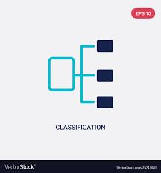


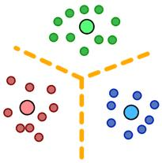

Project Distribution
PART – 1
Use of PAI
PART – 2
Use of DWS (Python 3)
Exploratory Data Analysis
Classification Models
Prediction using Neural Network
Recommendation System
K-means Clustering

Slide 5
Dataset description
Age
Sex
chest pain type (4 values)
resting blood pressure
serum cholestoral in mg/dl
fasting blood sugar > 120 mg/dl
resting electrocardiographic results (values 0,1,2)
maximum heart rate achieved
exercise induced angina
oldpeak = ST depression induced by exercise relative to rest
the slope of the peak exercise ST segment
number of major vessels (0-3) colored by flourosopy
thal: 3 = normal; 6 = fixed defect; 7 = reversible defect

Slide 6
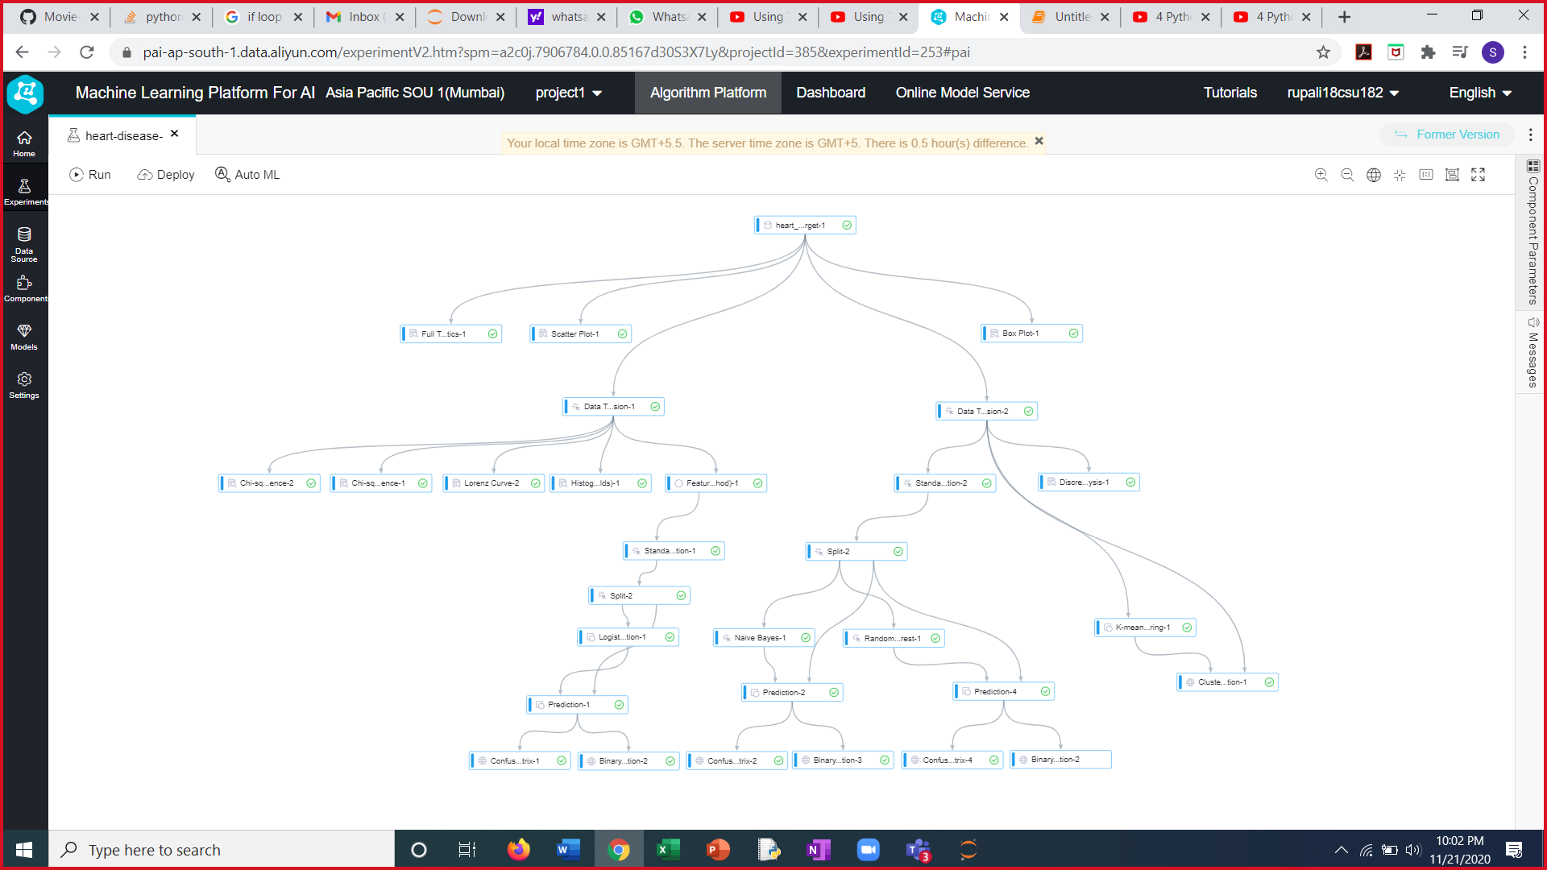
PAI FLOWCHART

Slide 7
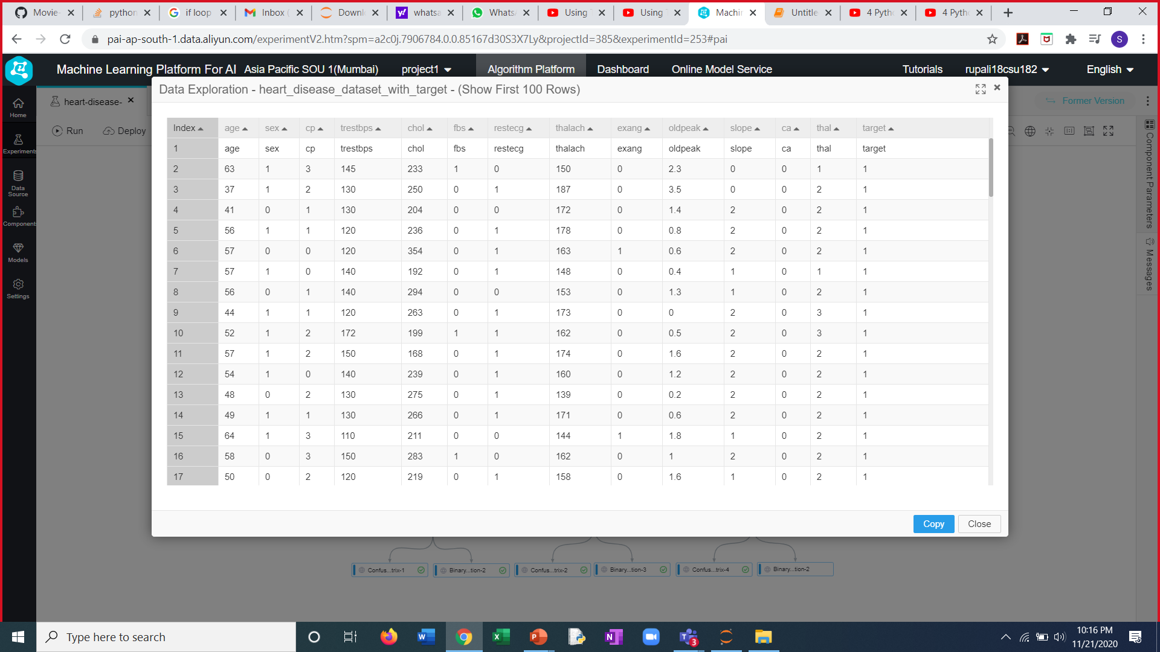
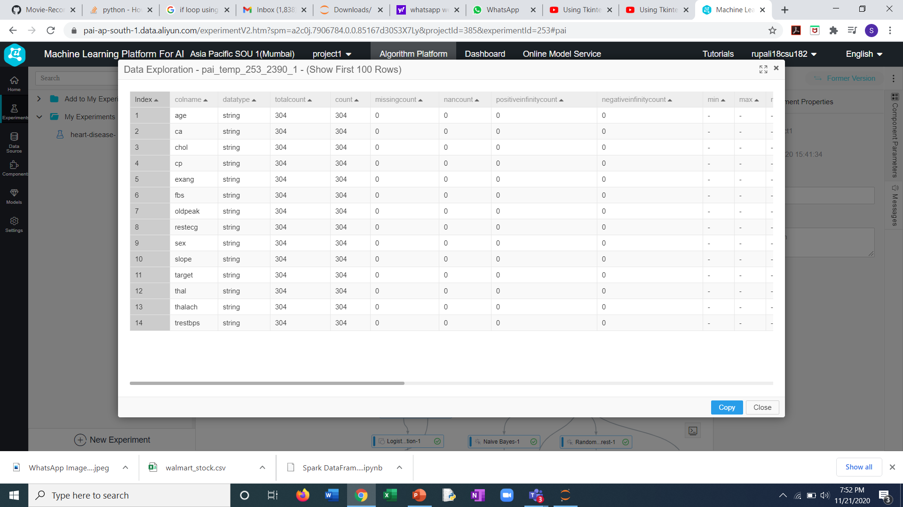
Dataset
Fig.1: Importing Dataset
Fig.2: Full Test Statistics

Slide 8
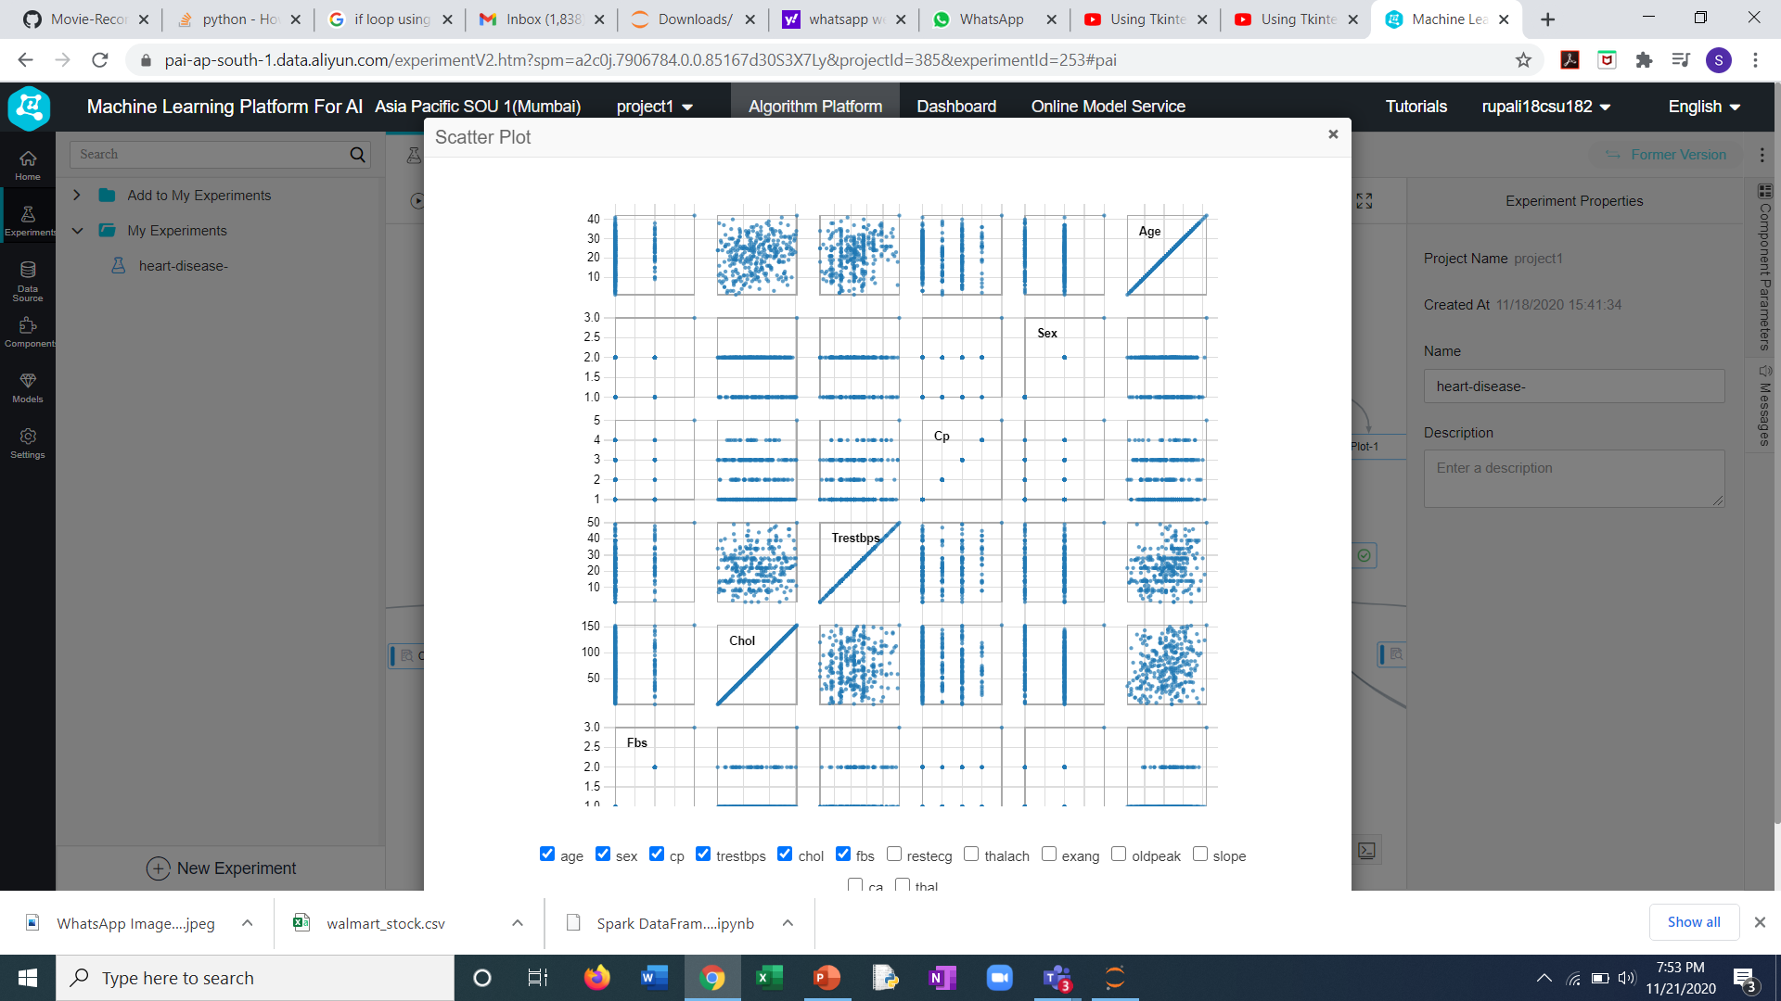
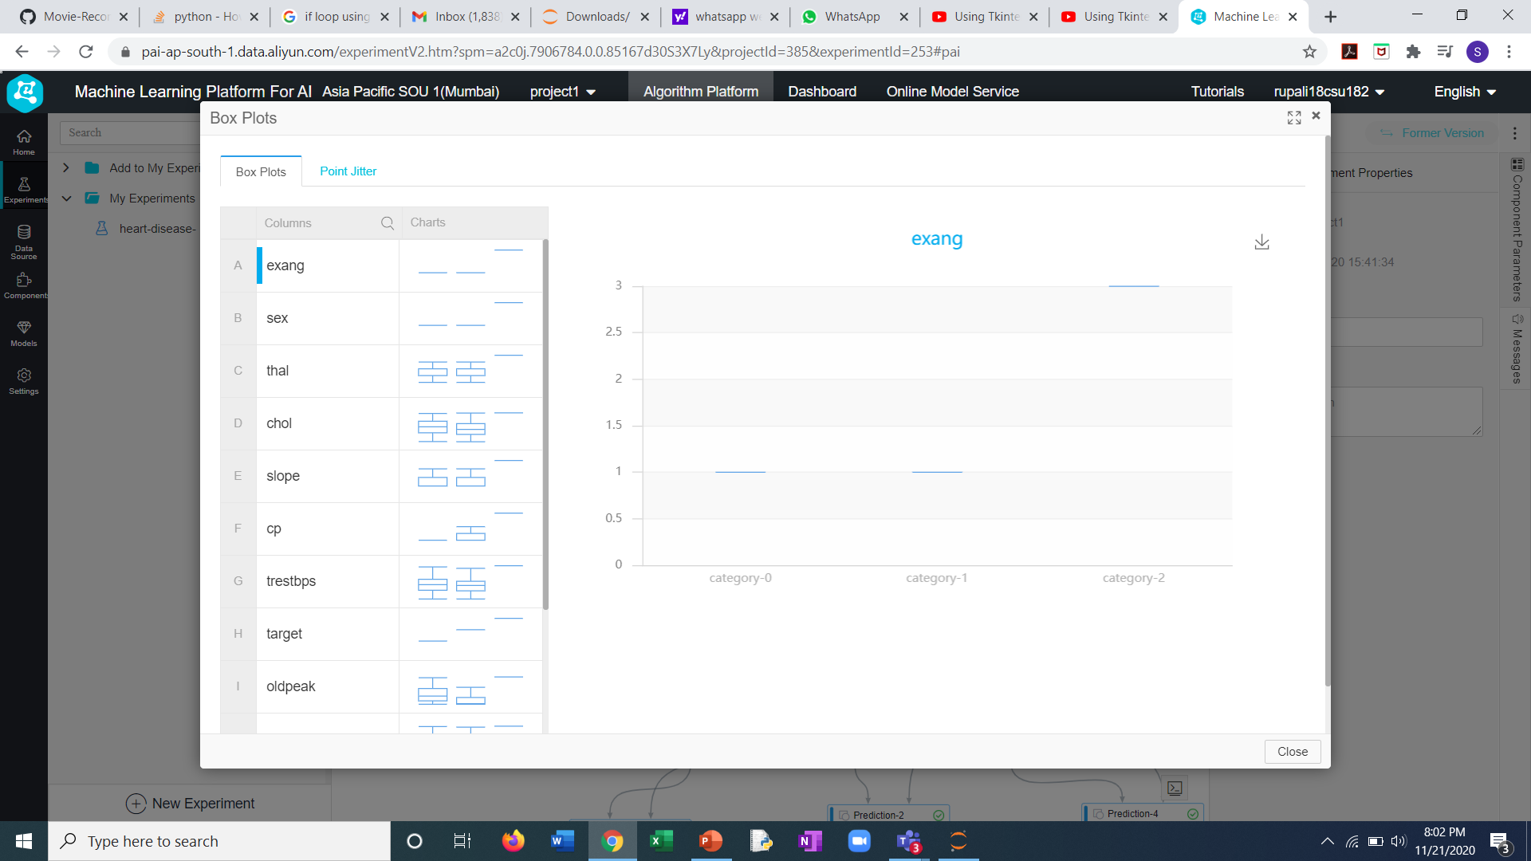
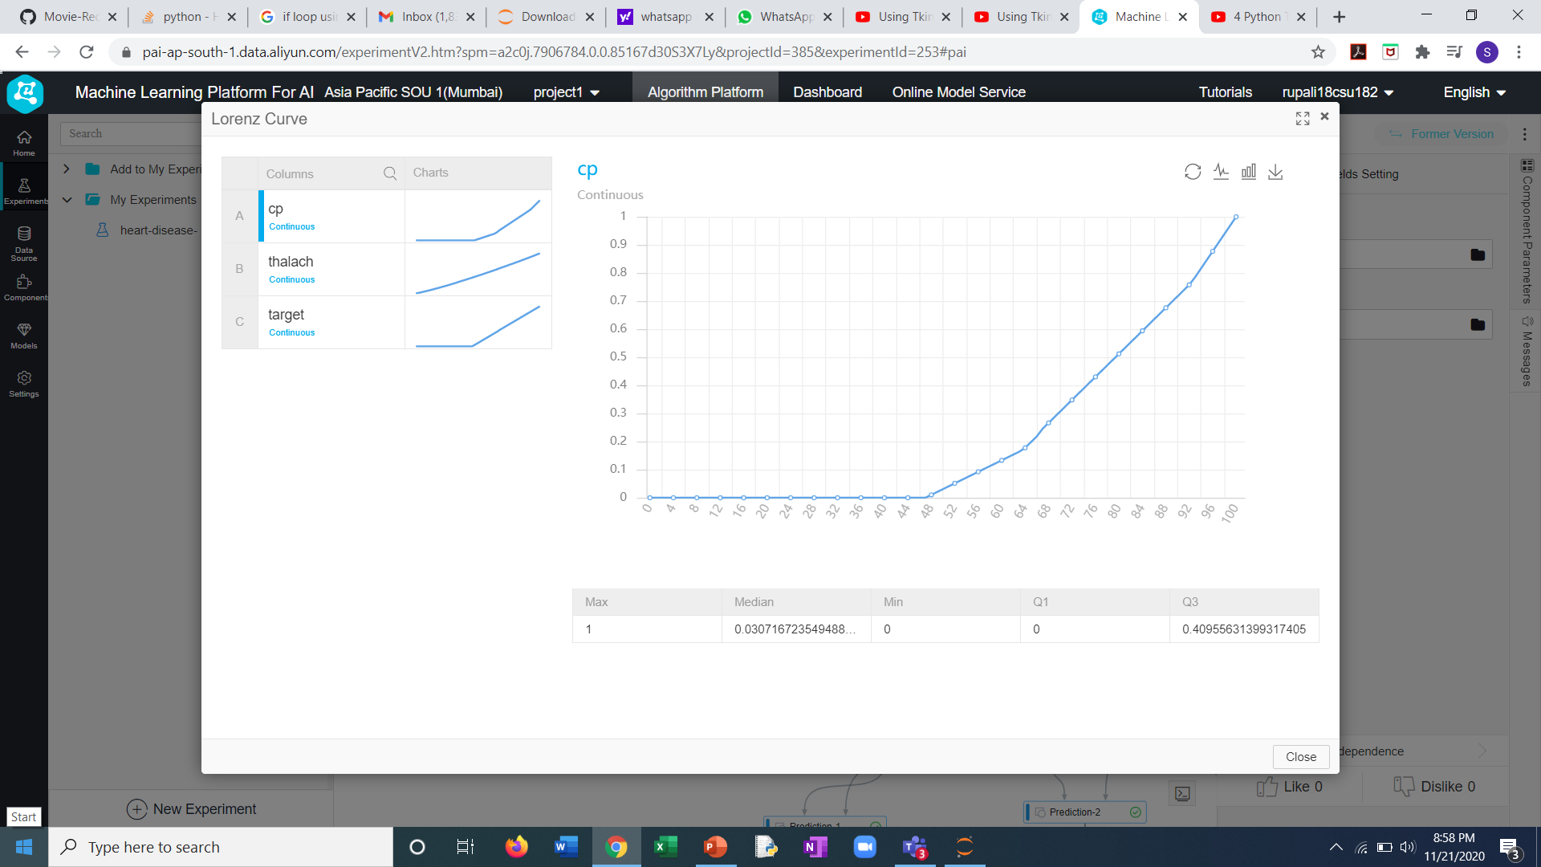
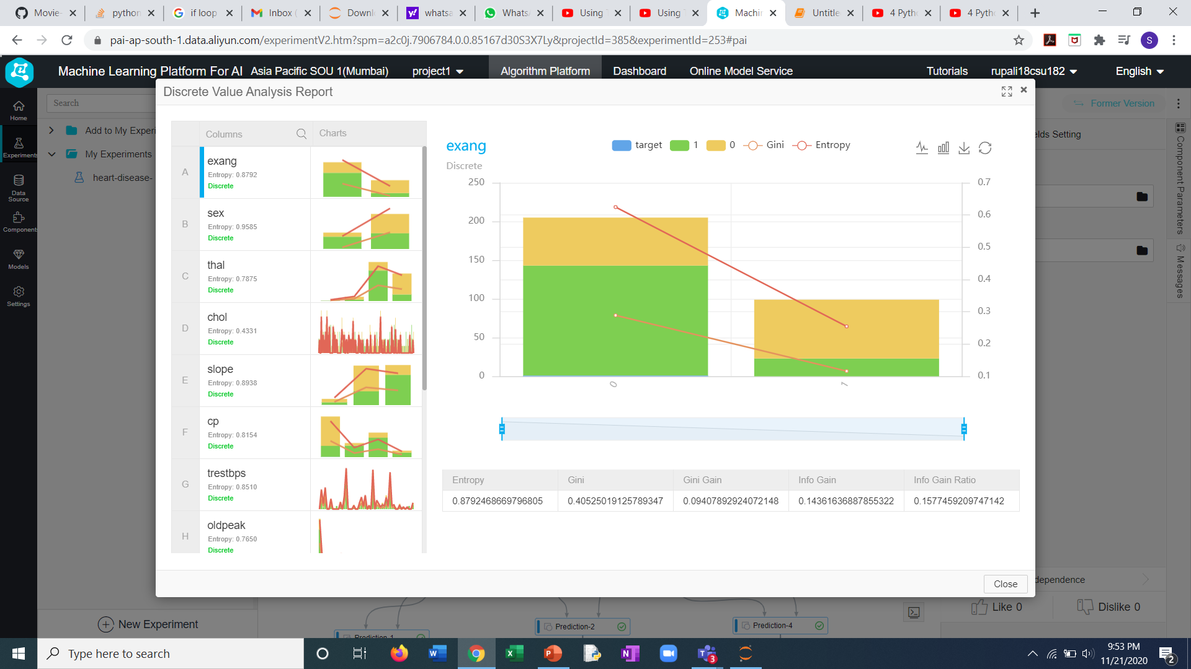
Exploratory Data Analysis

Slide 9
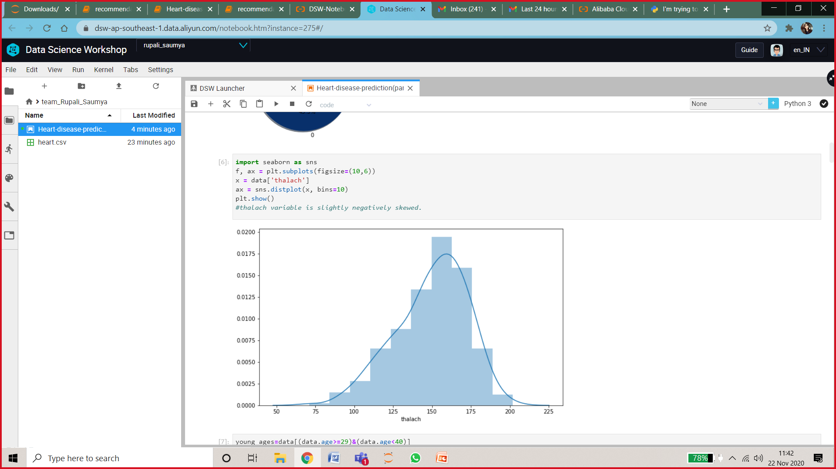
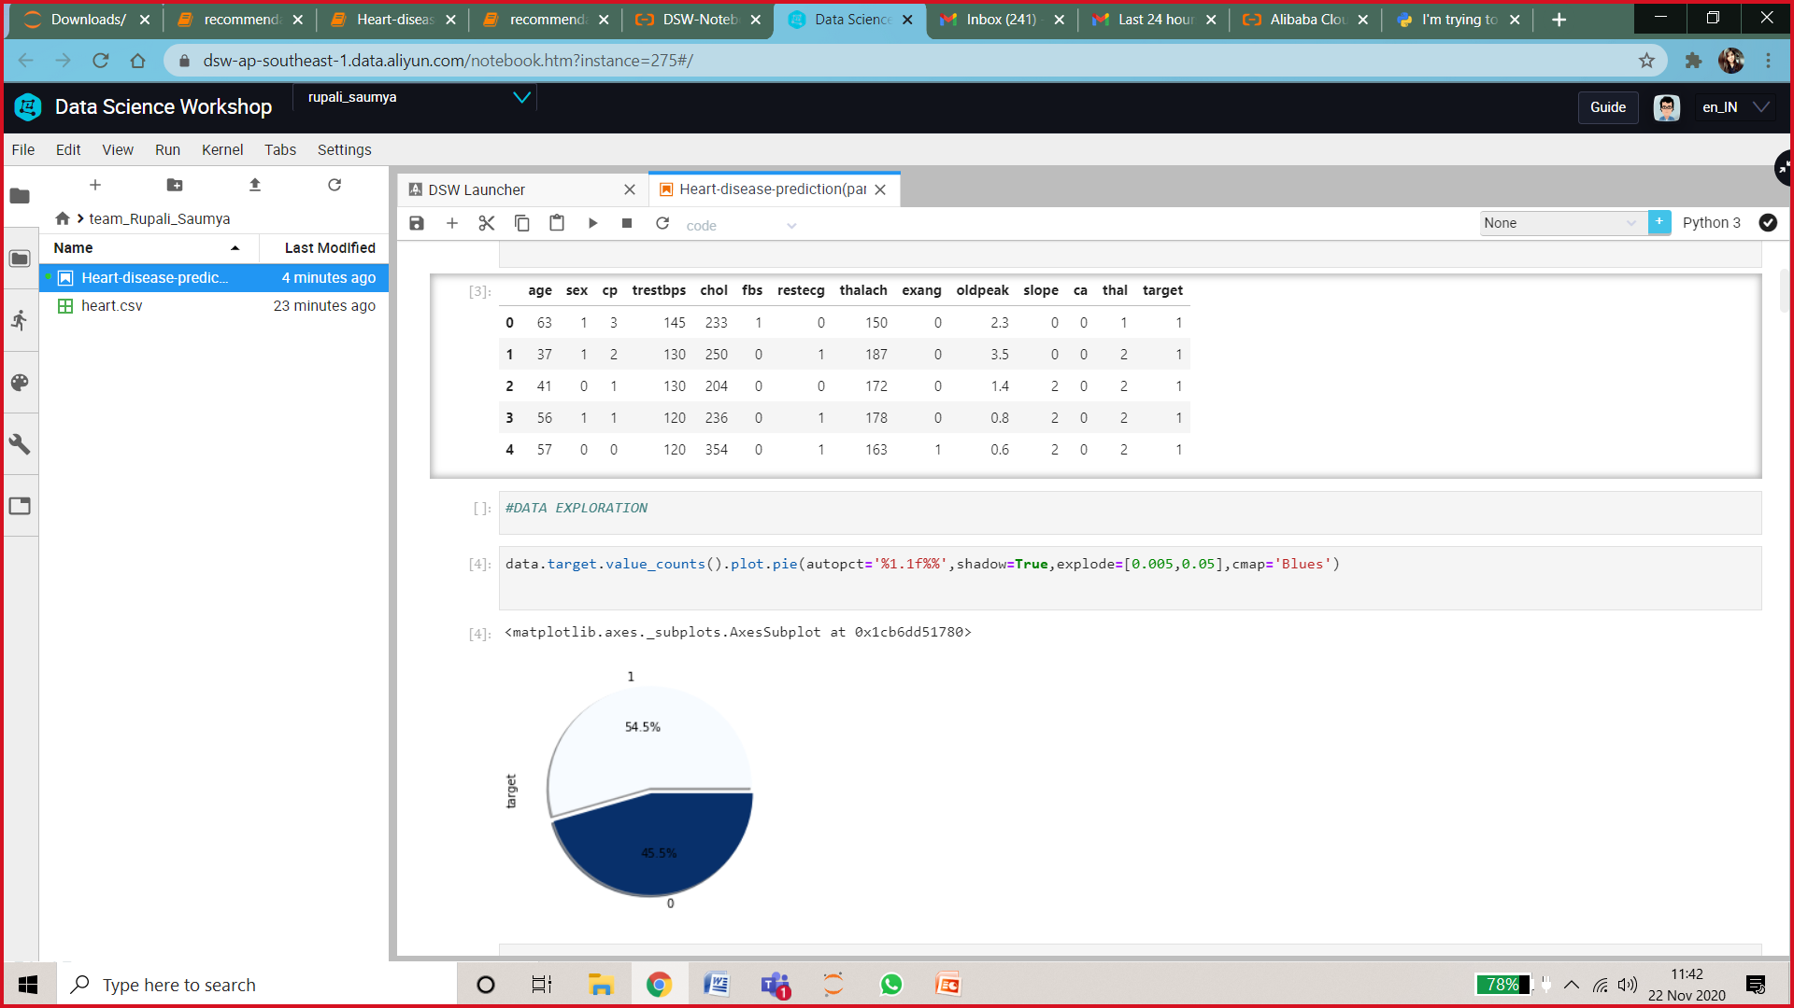
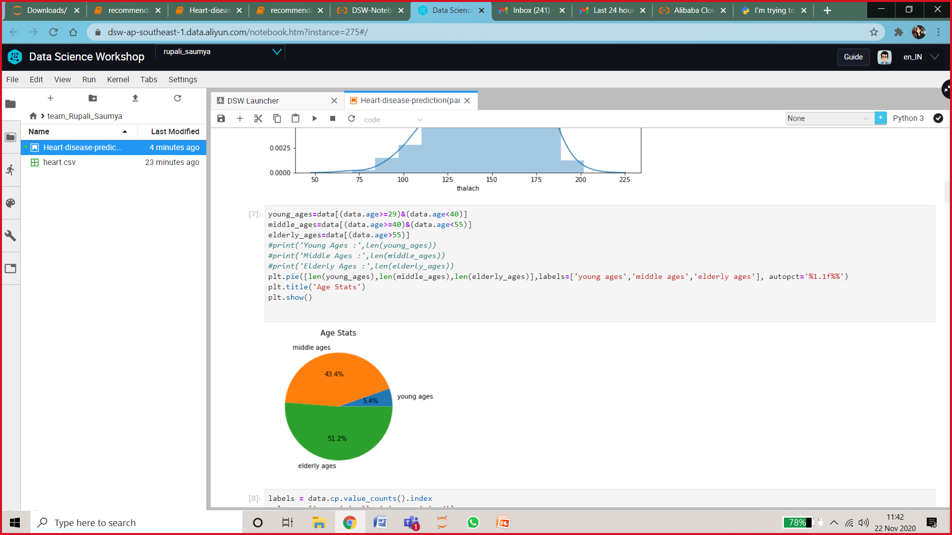
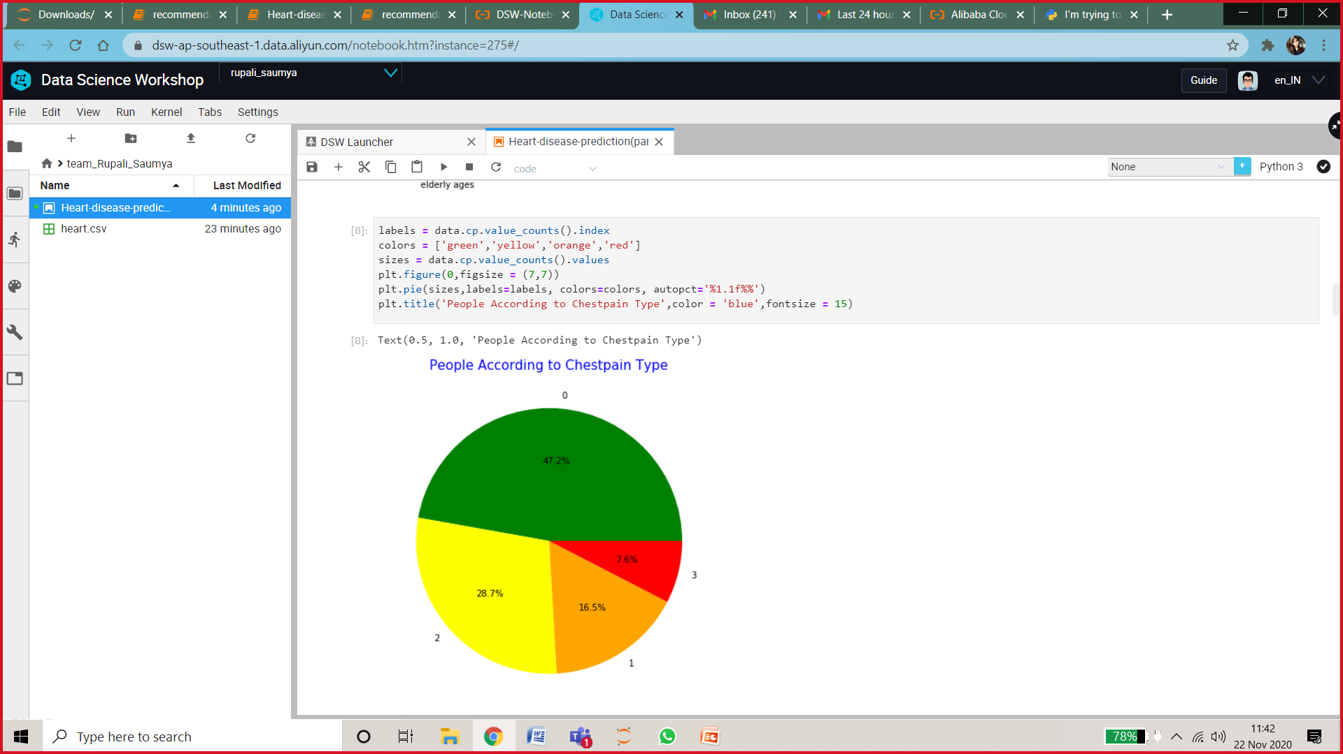

Slide 10
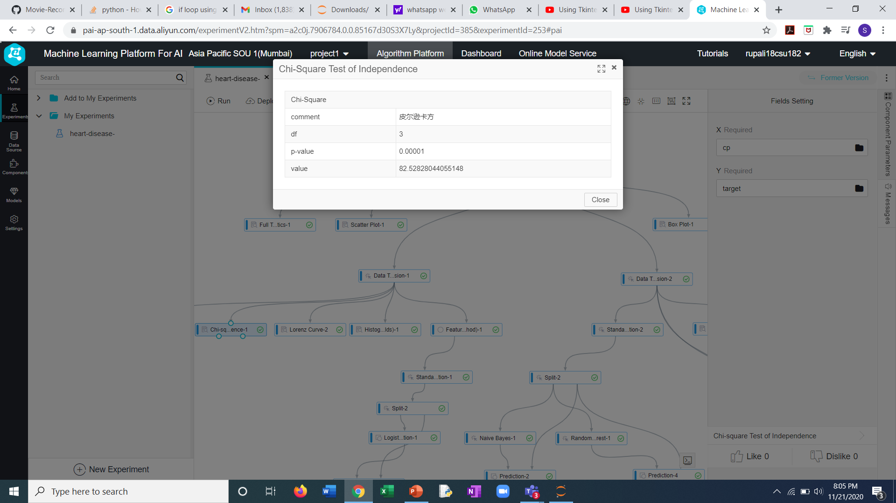

Chi square Testing
The Chi-Square Test of Independence determines whether there is an association between categorical variables (i.e., whether the variables are independent or related).
Chi Square Test for The attribute – CP(Chest Pain Type)
Chi Square Test for The attribute – CP(Chest Pain Type)
Chi Square Test for The attribute - CP
THALAC

Slide 11
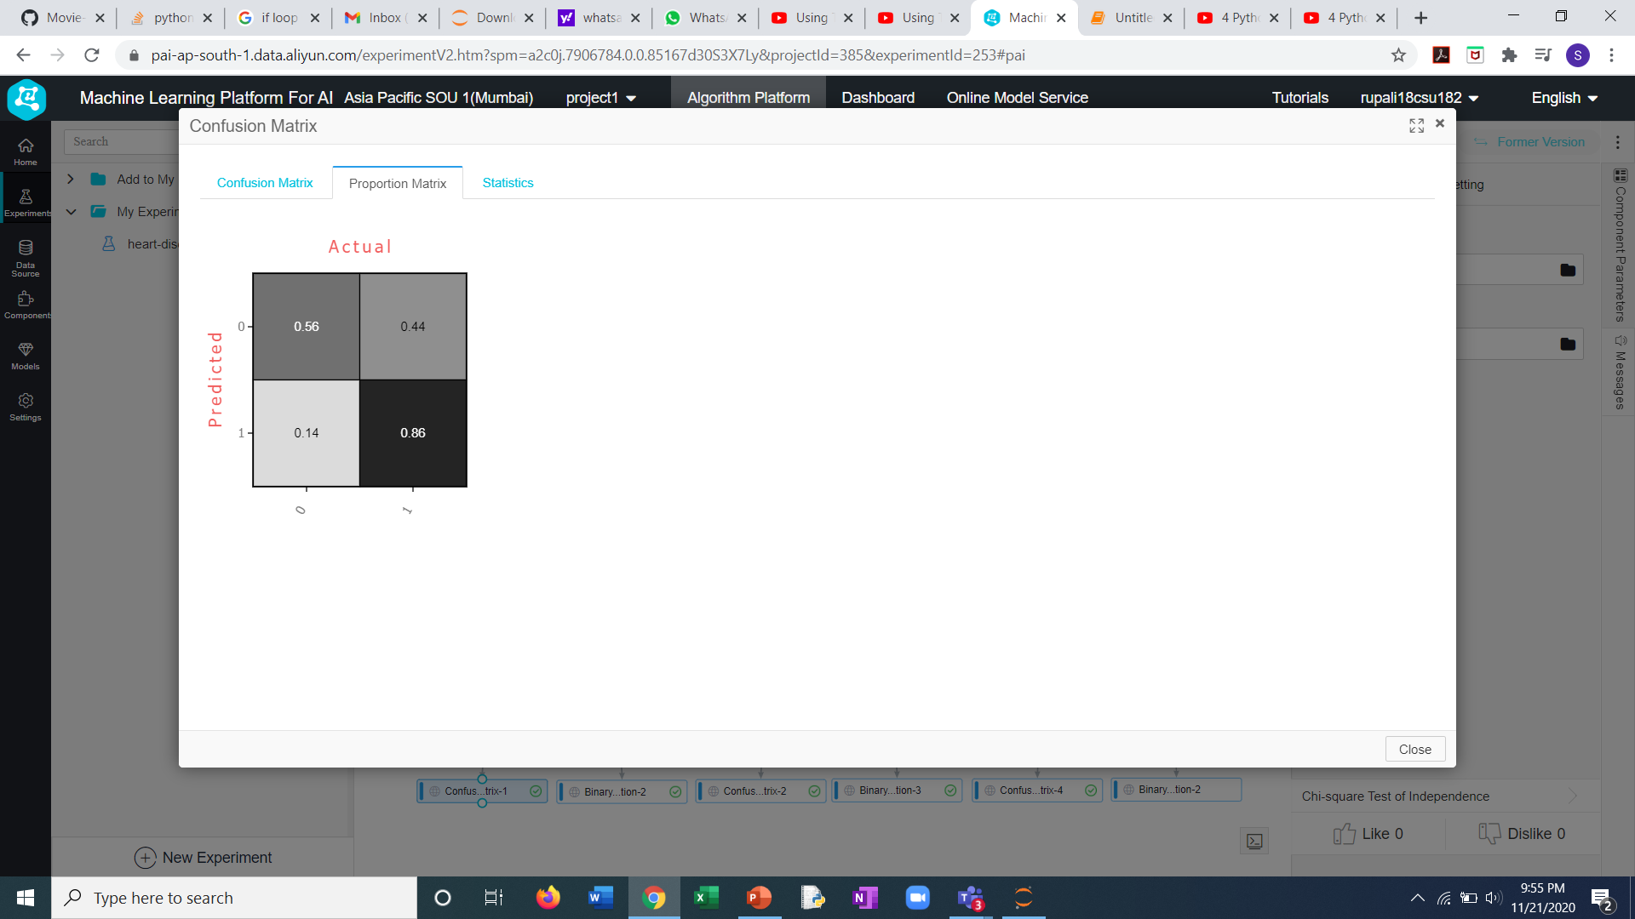
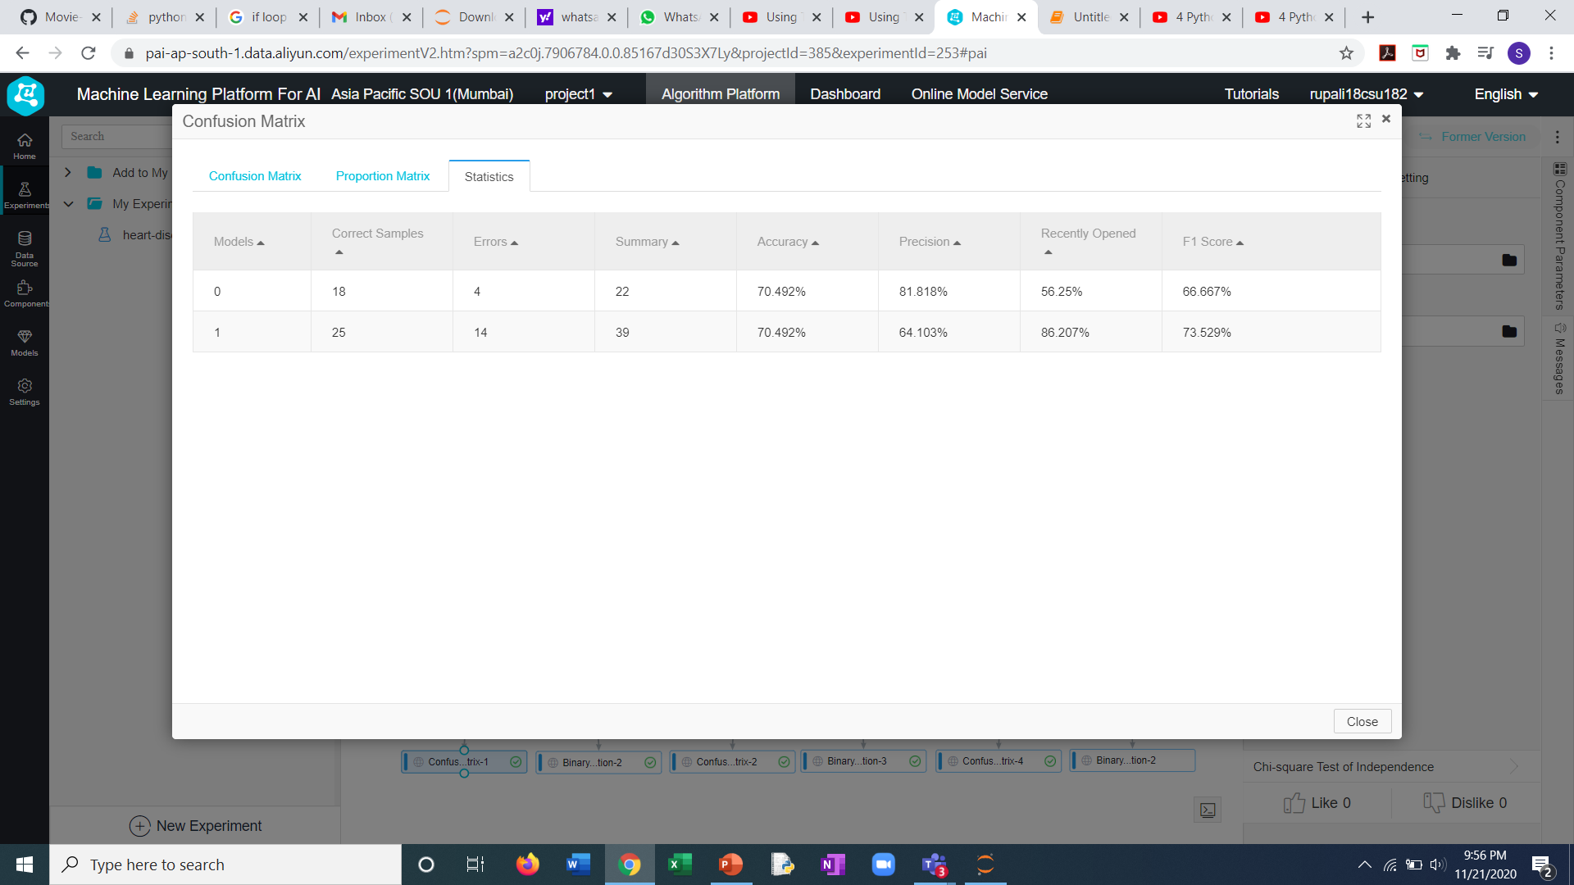
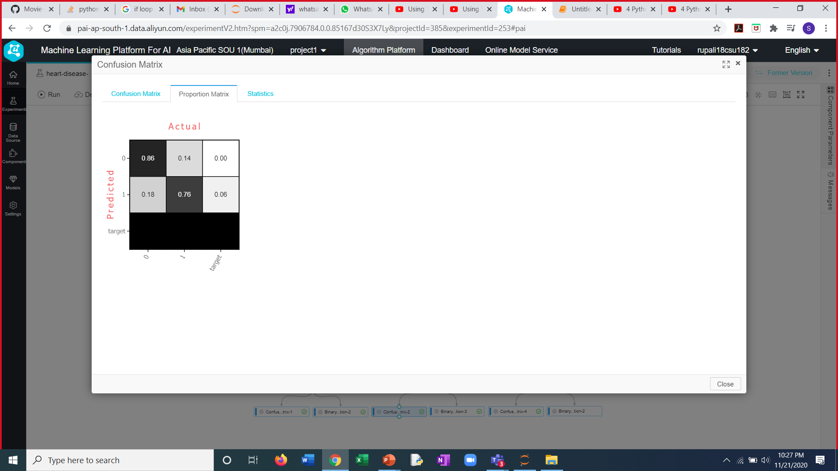
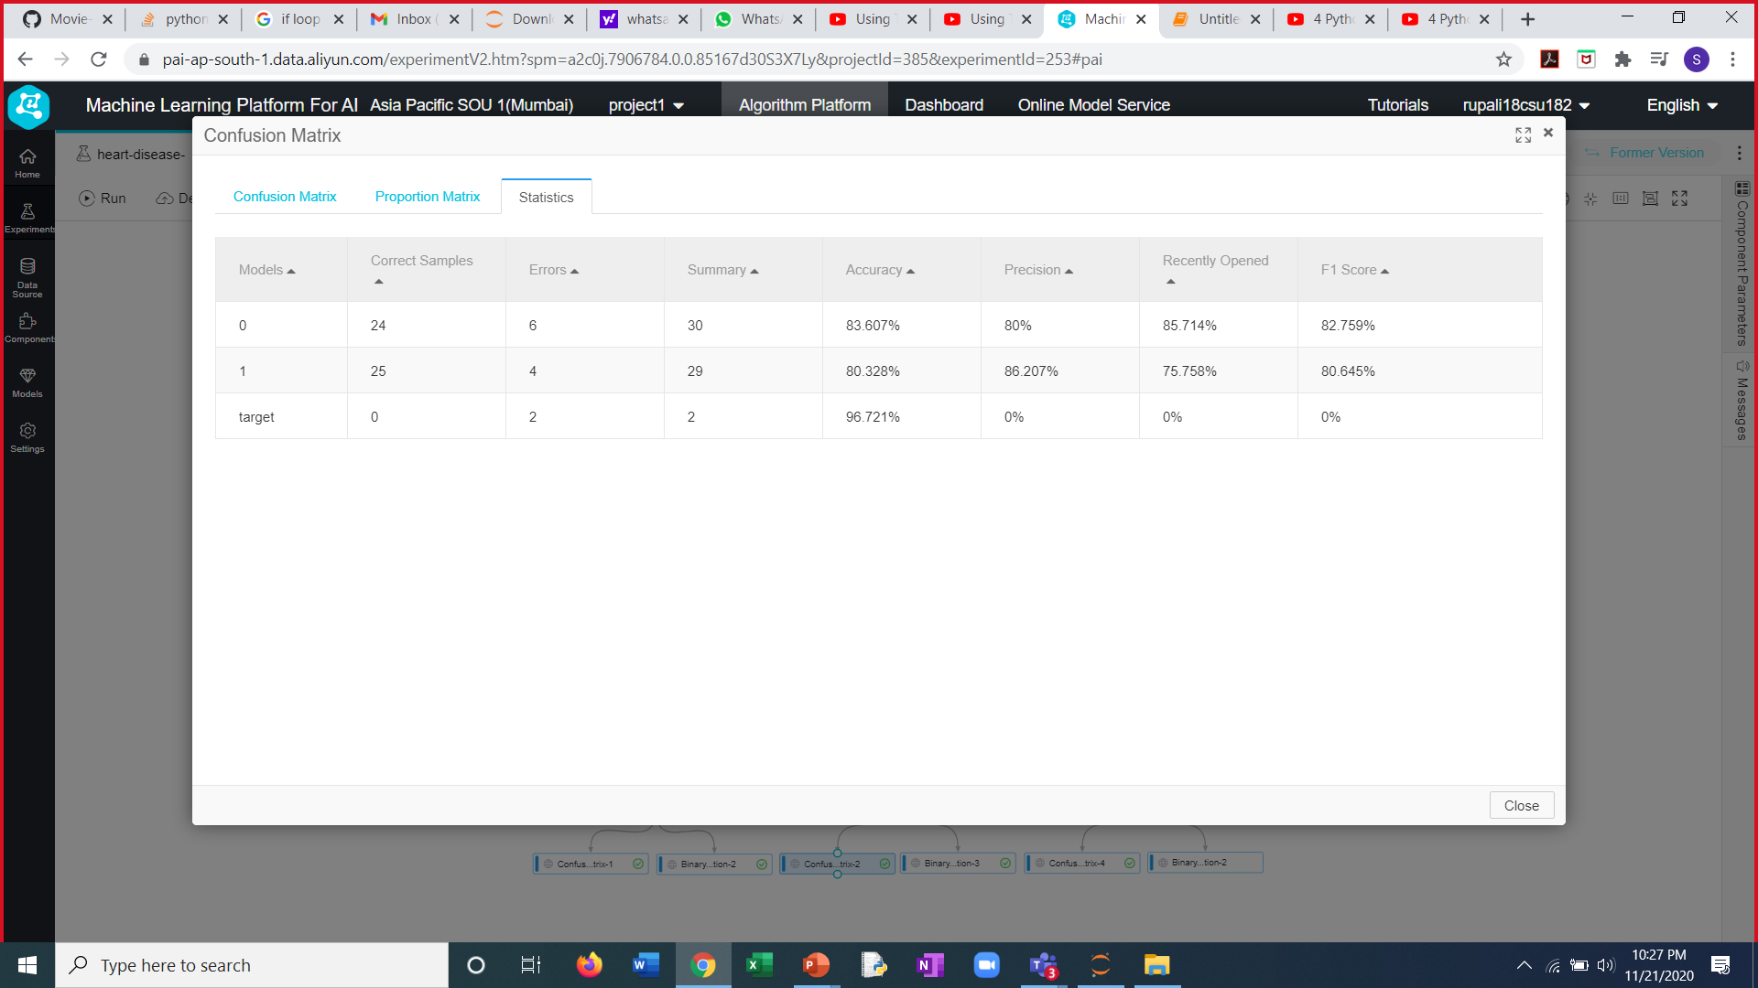
Prediction using Classification Algorithms
1. Logistic Regression
Accuracy of LR model is 70.492%
2. Naive bayes
Accuracy of NB classifier is 80.328%

Slide 12
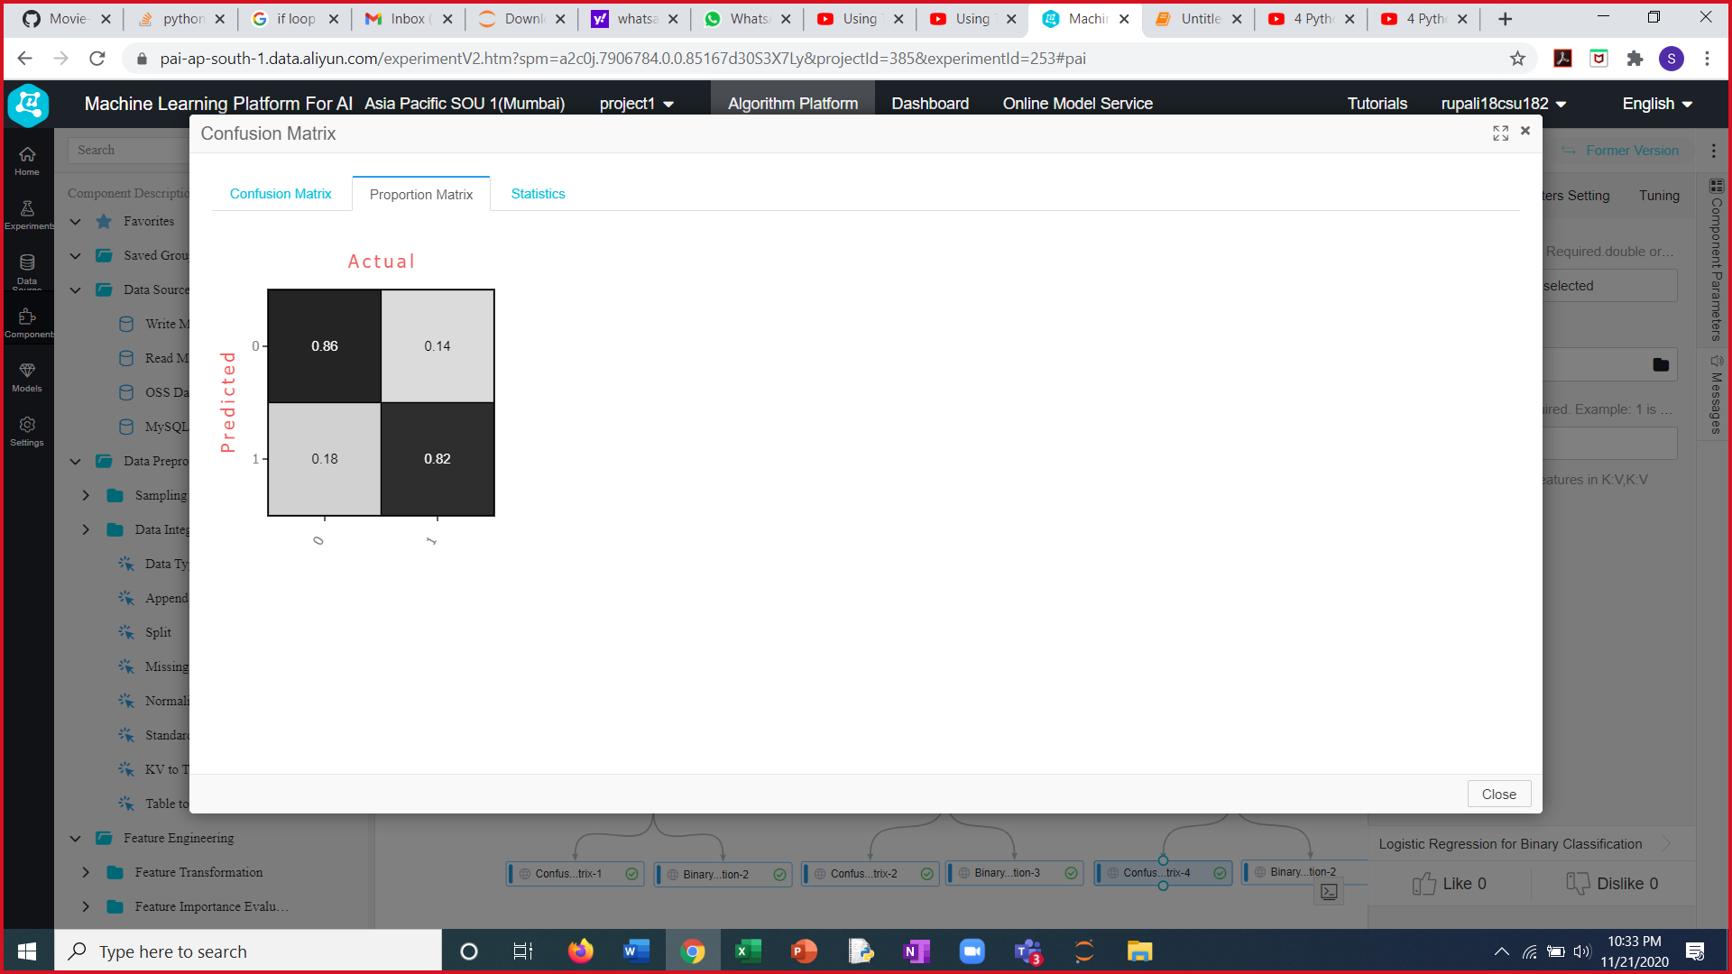
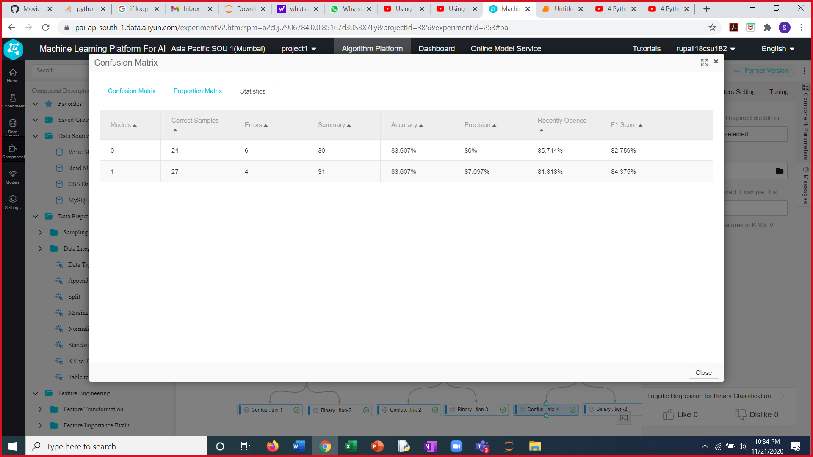
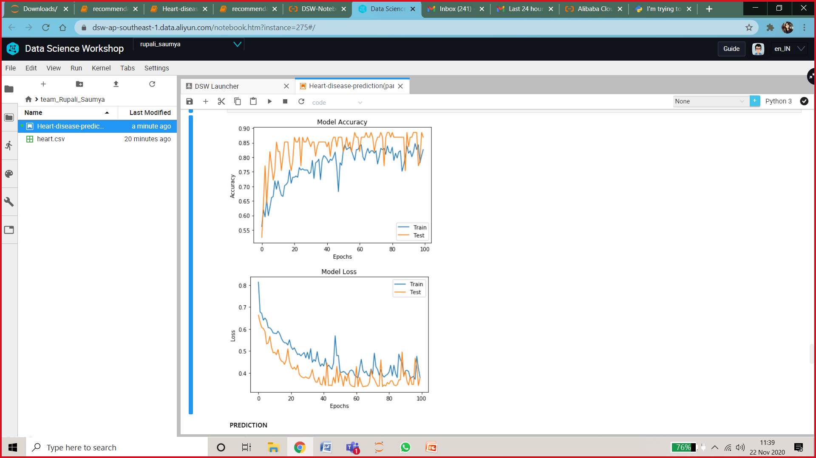
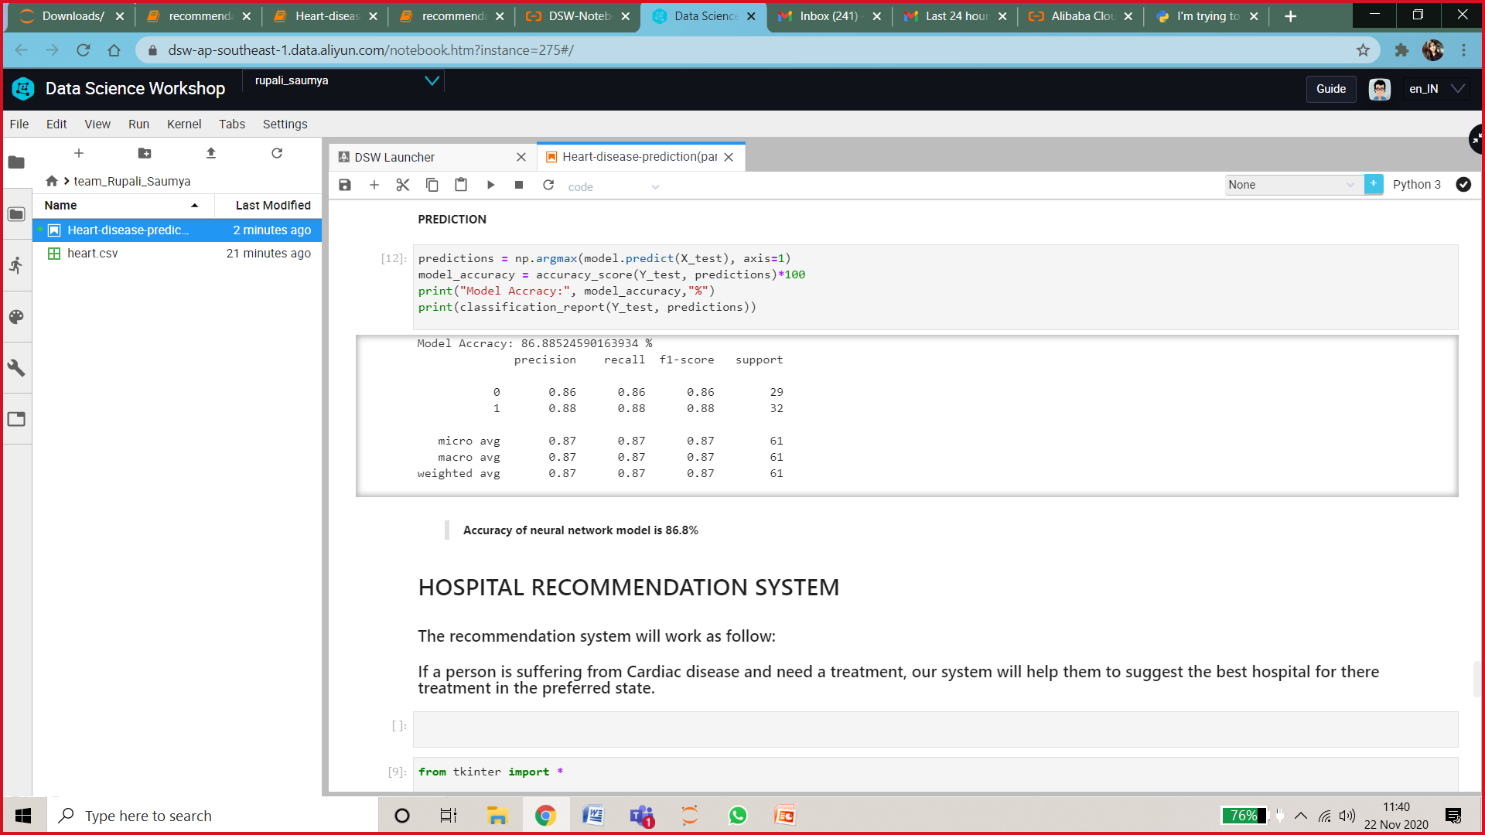
Continue….
3. random forest
Accuracy of RF is 83.607%
4. Neural network prediction
Accuracy of Neural Network is 86.89%

Slide 13
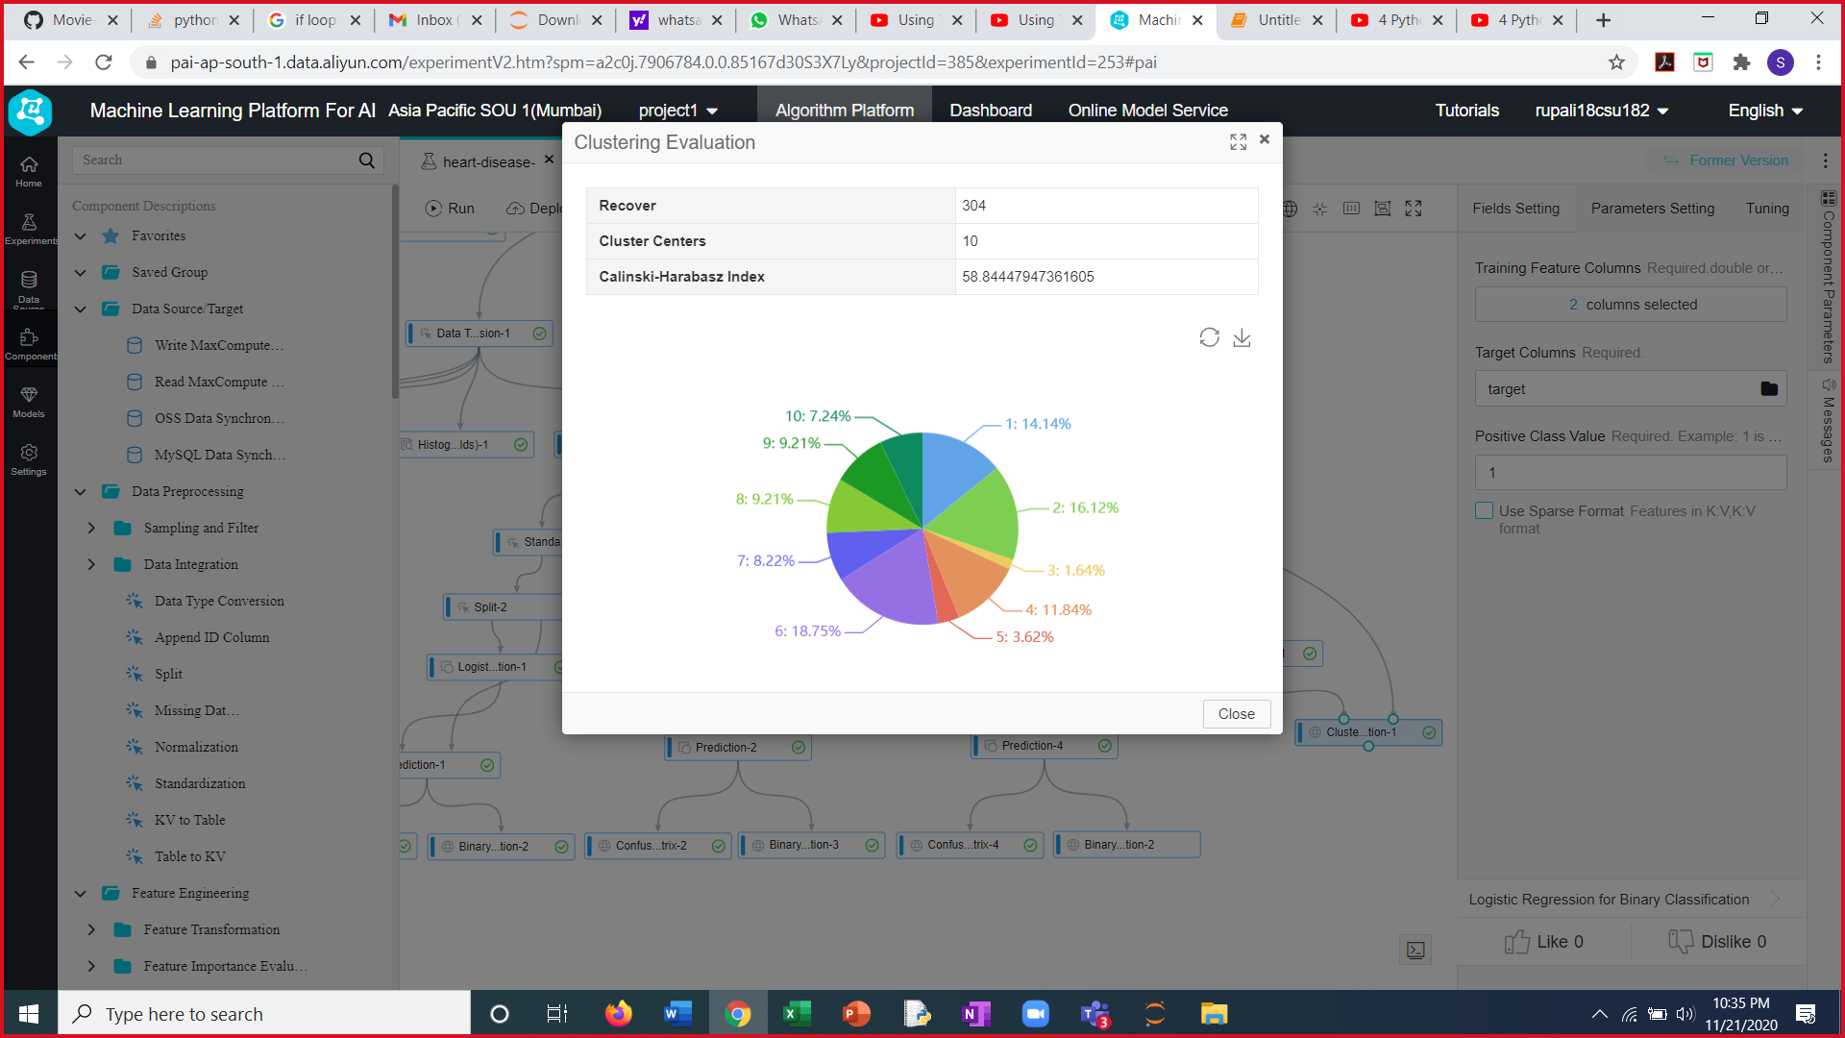
K-Means Clustering
The model formed 10 clusters.
The evaluation metric used is Calinski-Harabasz Index.
Result of Prediction Models
MODEL | Logistic Regression | Naive Bayes | Random Forest | Neural Network
ACCURACY | 70.492% | 80.328% | 83.607% | 86.89%
Neural Network model has the highest accuracy. Therefore, it can be used to predict heart disease.

Slide 14
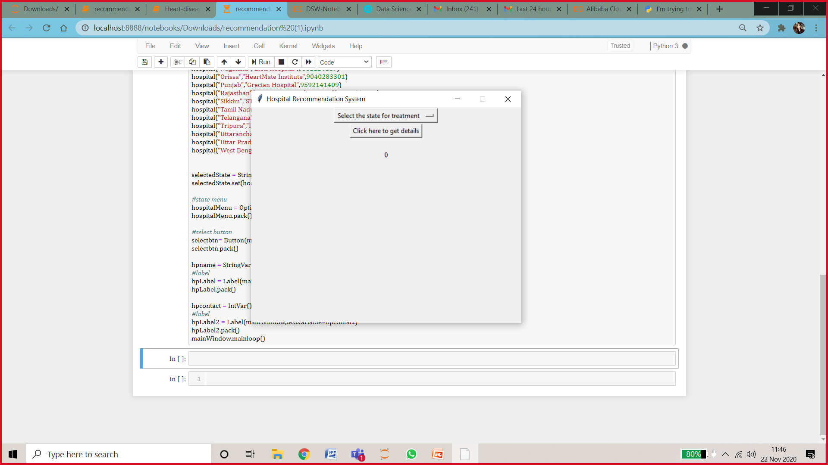

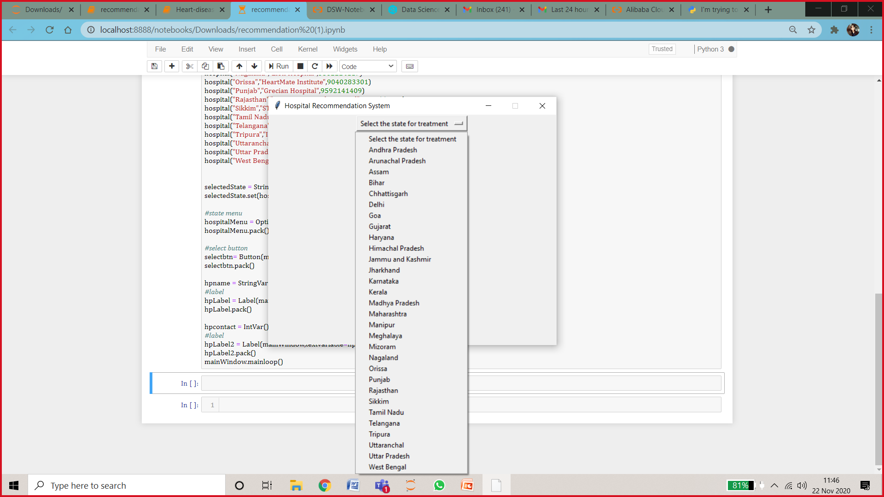
Recommendation system
The recommendation system will work as follows:
If a person is suffering from Cardiac disease and need a treatment, our system will help them by suggesting the best hospital for there treatment in the preferred state.
Fig.1
Fig.3
Fig.2

Slide 15
Thank you

